Slide 1
What is Health Data Science?

Slide 2
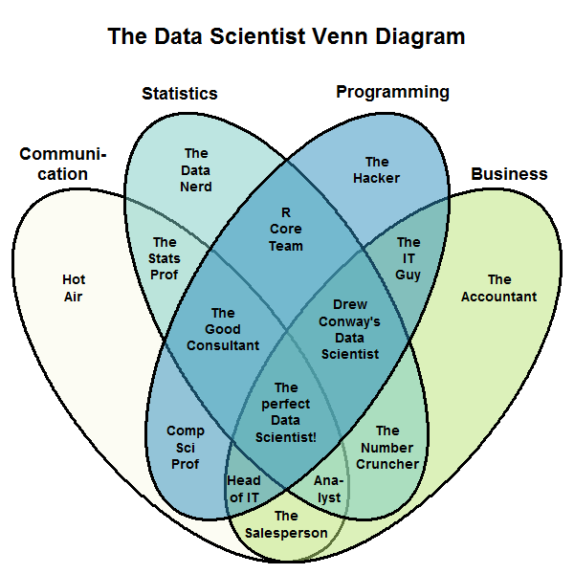
What is Health Data Science?
Source: Stephan Kolassa https://commons.wikimedia.org/wiki/File:Data_scientist_Venn_diagram.png

Slide 3
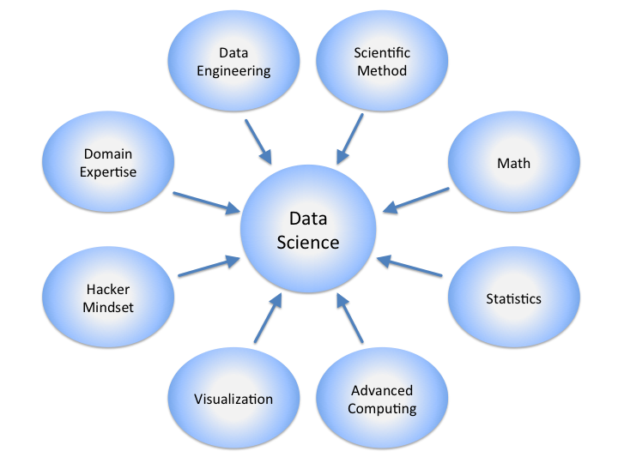
What is Health Data Science?
Source: Calvin.Andrus https://commons.wikimedia.org/wiki/File:DataScienceDisciplines.png

Slide 4
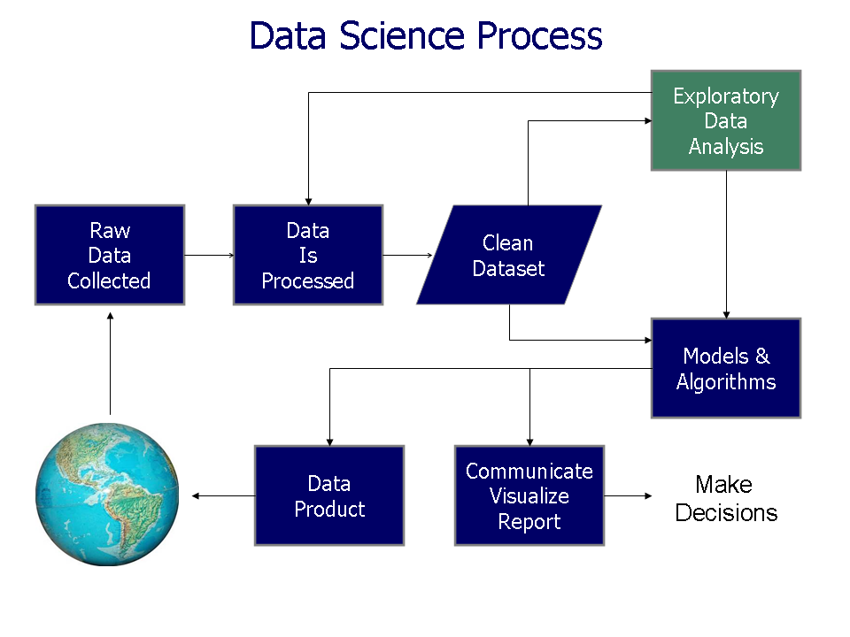
What is Health Data Science?
Source: Seonjae Jo https://www.flickr.com/photos/130860834@N02/19786840570

Slide 5
What is Health Data Science?
Data
+
Science

Slide 6
What is Data Science?
Turning data into knowledge.
(in health)

Slide 7
What is Health Data Science?
An emerging field driven by advances in
Data storage capacity
Computing power
Computational techniques
Operational data collection and use
Big Data* in health
*Big Data is a nearly meaningless buzzword, and I do not endorse the use of this term when you can avoid it.

Slide 8
What is Health Data Science?
Interdisciplinary
Healthcare providers
Health researchers
Statisticians
Computer Scientists
Software Engineers

Slide 9
The Data Revolution
Old Way
New Way
Small Sample Population
Collect Data Existing Data
Rigid Experimental Design Flexibility
Separation between Evidence used
Research and Practice Operationally
Replication Difficult Replication can be
Trivial

Slide 10
The Data Revolution
Gaining knowledge about health used to be expensive and slow, and the relationship between knowledge gained and effort was roughly linear.

Slide 11
The Data Revolution
Gaining knowledge with modern data and techniques
Fast
Inexpensive
Massive economies of scale
Repeat, repurpose, iteratively improve

Slide 12
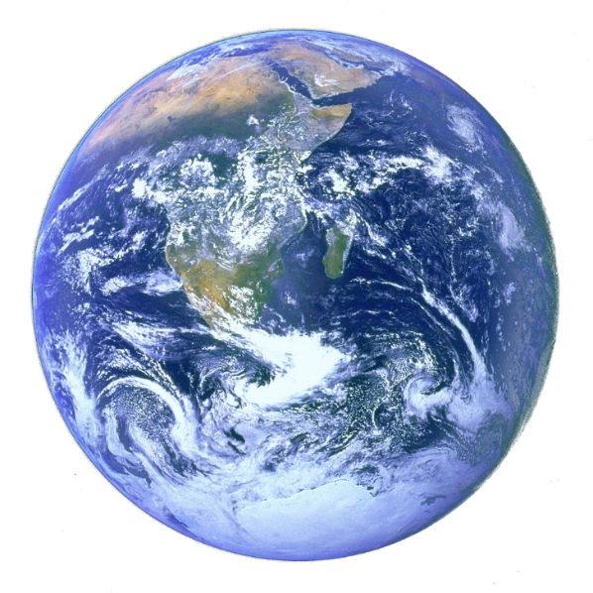
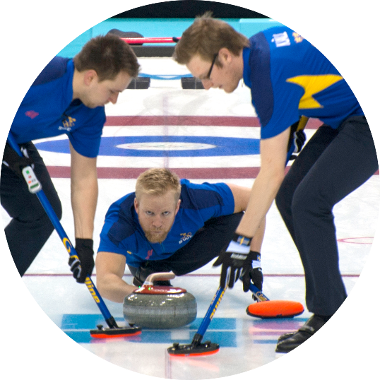

The Linked Data Revolution
Scale
Speed
Cost
Dramatic reduction in the difficulty of answering one ?
Notes:
Anonymised, Linked Routine Data is going to revolutionize research as much as technologies like the internet have revolutionized everyday life.

Slide 13


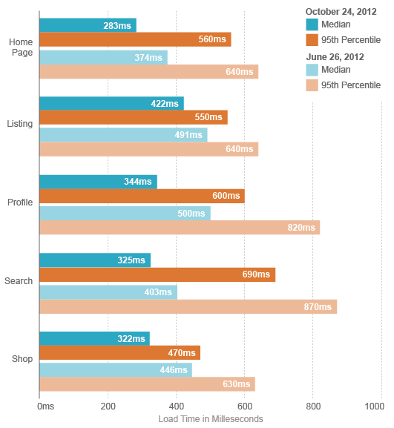
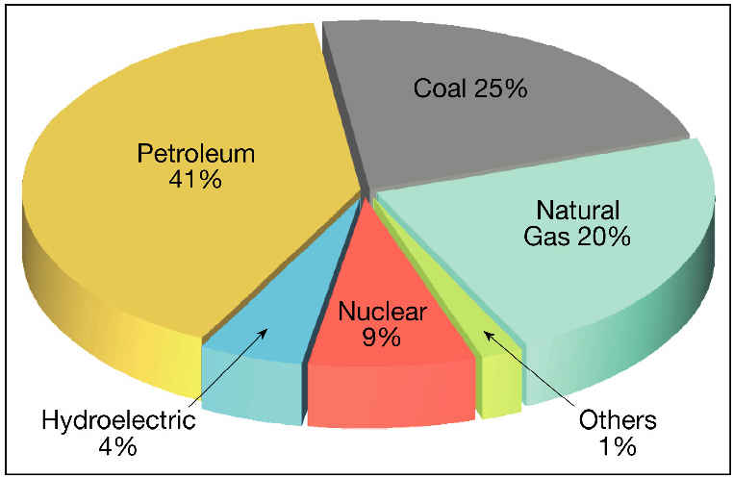
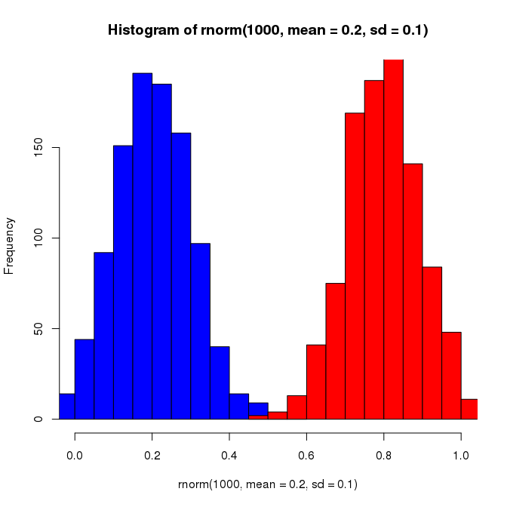
The Easy Life of a Health Data Scientist
Data
Step 1: Press Button
Step 2: Results come
out.
Do
Research
Notes:
The point of this slide is that doing research with data may seem very easy to outsiders.

Slide 14
The Easy Life of a Health Data Scientist
Results
Complex Stats
Data Errors
Journey Time:
3 Hours
Bias
Two Months
4 Days
Journal of Epidemiological Ponderosity
How We Spent the Last Two Years of Our Lives
Abstract
Incomplete Data
4 Weeks
Cohort Identification
Data
Notes:
Main challenge is that analysis is complex and highly technical. A lot of people working on SAIL have pointed out that their bosses say “just get this data”, not realizing how complex it is. It is understandable, since the data is all there, that they think it should be easy to get results. But in real life there are many issues that add complexity.
Multiple layers of complexity.

Slide 15
The Data Revolution
Gaining knowledge with modern data and techniques
Fast
Inexpensive
Massive economies of scale
Repeat, repurpose, iteratively improve
should be

Slide 16
Health Data Science Example 1
Google Flu Trends
When people have the flu they search for certain keywords.
Compare historic flu data to search term data.
Result: a model that could track flu outbreaks almost instantly!
10 days faster than the Centers for Disease Control and Prevention (US).
Notes:
Google flu trends was a project where there were initially high expectations of the benefits of “big data” in health. However, it failed. Here is an article about it: https://www.wired.com/2015/10/can-learn-epic-failure-google-flu-trends/

Slide 17
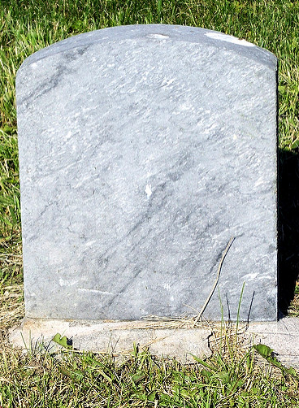
Health Data Science Example 1
Initially promising, failed in longer term.
Why?
Changes in search usage over time.
Search terms not specific to flu
Associations with seasonal but unrelated words
Google Flu Trends
2008 - 2015
Image by Jo Naylor (modified) licenced under CC BY 2.0

Slide 18
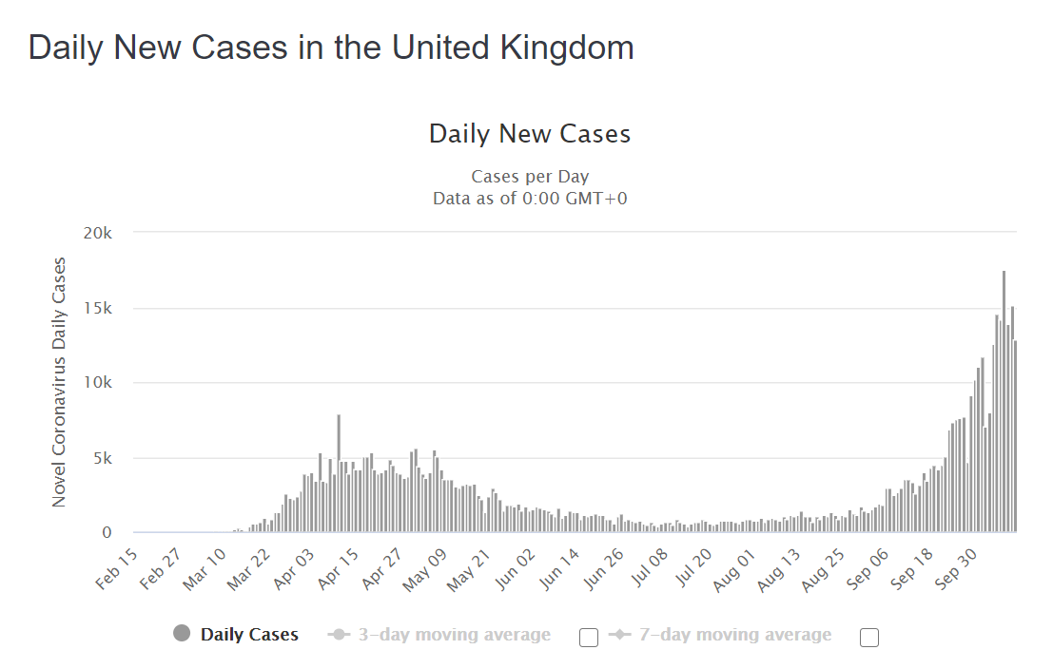
Health Data Science Example 2
Notes:
I discussed the AIR Aware project and some of the complexities of it. It may be useful to substitute another project you are familiar with if someone else takes these slides.

Slide 19
COVID-19: Data Science Becomes Critical
Immediate need for information/analysis:
Surveillance
Transmission mechanisms
Outcomes and risk factors
Critical impact
Decisions about travel, lockdowns, etc.
Health service capacity
Population guidelines
Make or break moment

Slide 20
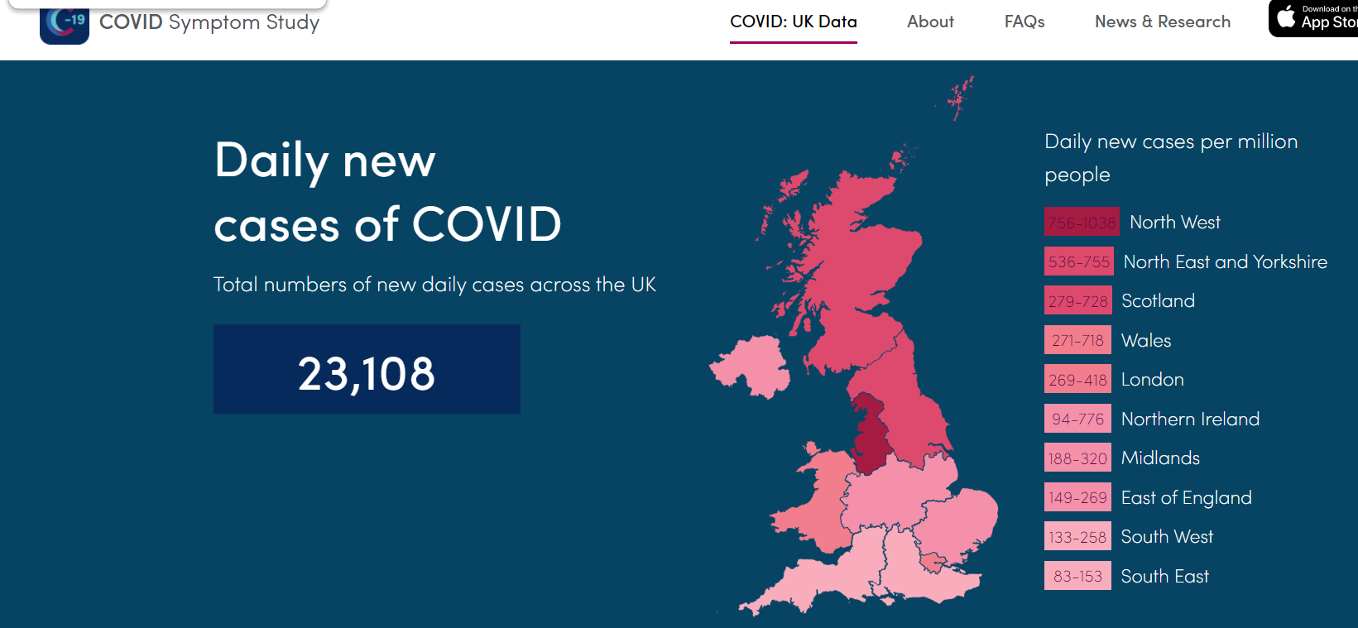
COVID-19: Make or break

Slide 21
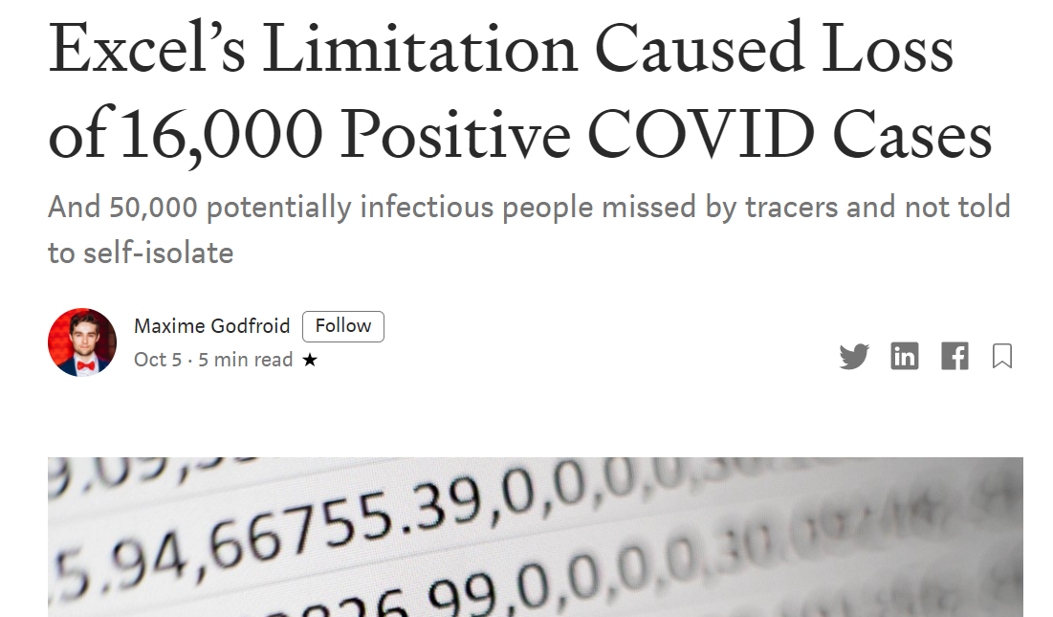
COVID-19: Make or break

Slide 22
COVID-19: Communication Is Critical
Must step beyond merely doing impressive technical work.
If you can’t adequately communicate something to non-experts it will have no impact.
Competing narratives, all claiming to be data driven.

Slide 23
COVID-19: Communication Is Critical
Misinterpretations of data/findings.
Death reporting
Simplistic analysis.
Second wave: cases rise, but not deaths.
Outright false information masquerading as fact.
Stats and numbers make something seem “scientific”.

Slide 24
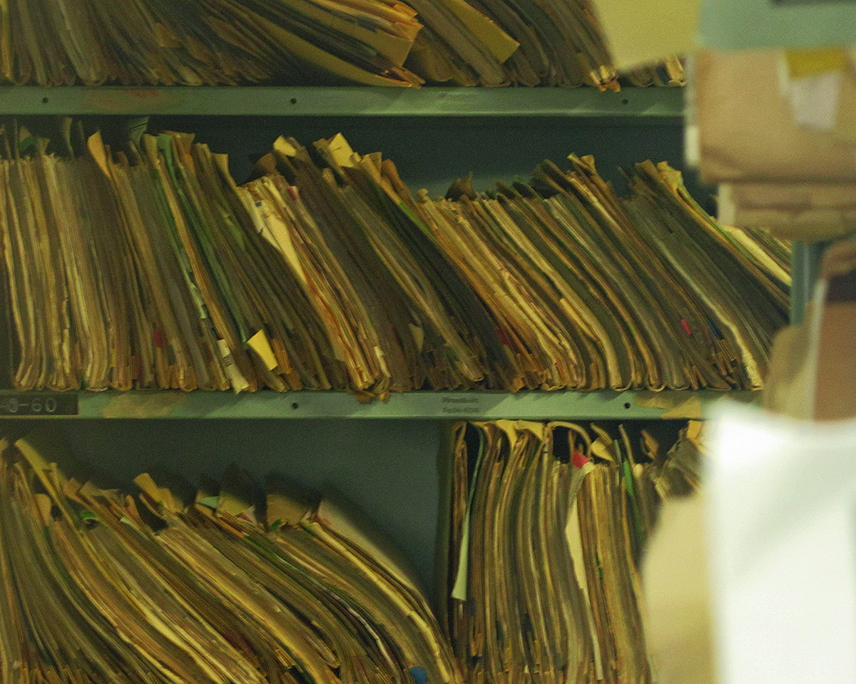
And now, to the data…
Notes:
One of the major issues is the messiness of real-world data.

Slide 25
Real world data: primary care in Wales
Each practice has their own database for their patients.
GP records on a system during appointment.
Coding system (Read codes) for recording symptoms, diagnosis, treatment, etc.
Sometimes used, sometimes just text.
Data also entered at other times
Receiving a letter from hospital, yearly “clean up” of system, etc.

Slide 26
Real world data: secondary care in Wales
Each hospital has their own system.
Later joined into national dataset: Patient Episode Database for Wales (PEDW)
Standards published for all health boards to follow.
Electronic systems record patient admission to hospital, etc.
Diagnosis and treatment information handwritten on paper initially.
Some later transcribed to electronic system by another person (clinical coder).
Diagnoses in International Classification of Diseases 10 (ICD-10).
Multiple diagnoses per period of care.
First diagnosis = primary thing being treated.

Slide 27
Health Data at the Point of Collection
Data collected to support the work of doctors, care workers, and the health system.
Sometimes paper, transferred to computer later.
Sometimes old, clunky systems.
Designed for specific operational purposes, not for “data science”.
Data is shaped by data collection.

Slide 28
Discussion – provenance matters 1
Doctors are required to provide a reason why they don’t prescribe recommended medication X to a patient. However, they are very busy and tend to view such reporting as an intrusion on their real work, so they leave it blank.
As a result, the software is modified to pop up a dialog box that doesn’t go away until the doctor types in the reason.
Notes:
This is a discussion exercise to think about the consequences of data collection. Imagine if entering data in a field was made mandatory. This would force people to enter something in the field, but that wouldn’t enforce good data. People may enter junk to make it go away.

Slide 29
Discussion – provenance matters 2
AwesomeGP™ software version 1 requires doctors to navigate through four hierarchical screens to find the diagnosis code for a patient.
AwesomeGP™ 2 introduces a search that returns matching codes. This takes 4 seconds on the practice’s 386 computer, but later they upgrade to a Pentium, and it takes only 1 second.
In AwesomeGP™ 3, live suggestions appear instantly as a user types, ranked based on frequency of use at the practice.
Notes:
Another discussion for the class. What is the way that different data input methods might affect the data? If a diagnosis is easier to enter, then it might get entered more often. It might appear a disease is becoming more prevalent, when it is actually just the data. Also, a search suggestion might direct clinicians toward one particular code and away from others, introducing bias.

Slide 30
Discussion – provenance matters 3
Doctors used to create, print, and sign letters for referral to a specialist based on a Microsoft Word template.
Then AwesomeGP™ 4 comes out, which automatically creates and emails a patient referral letter and adds information about the referral to the patient’s record.
Notes:
Another discussion. This would cause referral letters to be coded more often in the data. It also might lead to an increase in actual referrals (perhaps).

Slide 31
Discussion – provenance matters 4
The national standards for clinical coding of hospital admissions require each health board’s data to have an average of at least 3 diagnosis codes per spell, with 90% of spells having a primary diagnosis listed.
Later this is increased to 5 codes and 98% of spells, respectively.
This increases the workload of clinical coders 20%, but only 5 out of 20 hospitals have funding to hire more coders.

Slide 32
Discussion
The national standards for clinical coding of hospital admissions require each health board’s data to have an average of at least 3 diagnosis codes per spell, with 90% of spells having a primary diagnosis listed.
Later this is increased to 5 codes and 98% of spells, respectively.
This increases the workload of clinical coders 20%, but only 5 out of 20 hospitals have funding to hire more coders.
Notes:
This might increase the quantity, but lower the quality of diagnosis codes. Also, the impact would be uneven in different hospitals, perhaps making it look like certain hospitals are performing better or worse, or diseases are more prevalent in certain areas, when actually it’s just the data.

Slide 33
Health Data Science: Conclusions
Gap between promise and reality. Let’s be part of the solution!
Real world data is messy; understanding the messiness is critical.

Slide 34
Being Part of the Solution Data Science Toolkit (for this module)
R Statistical programming
Relational Database/SQL Data storage, manipulation
Git Version control
Software Development Methodology Saving the world

Slide 35
R in a nutshell
Open source programming language and software environment for statistical computing and graphics
No license fee
Available for Windows, Linux and Apple Macintosh platforms
Based upon the S language (Bell Laboratories, 1970’s)
Growing in popularity (e.g. Google Scholar)
Slide courtesy of Joanne Demmler

Slide 36
Why use R?
Powerful statistics, plotting capabilities
Full-featured programming language
Much better than other statistical software
Free and open source
Vast library of user-created modules to perform specific tasks.

Slide 37
Alternatives to R
Alternatives you might want to use
Python
Alternatives someone might force you to use
SPSS
Stata
SAS
Please don’t
Excel

Slide 38
Relational databases in a nutshell
Data is stored in a set of 2D tables, each representing one “thing” (entity).
Tables are related to each other with keys.
Data stored and processed on disk, managed by relational database management software (RDBMS) for integrity, performance, efficiency.
Data stored, accessed, processed with SQL
Person
ID | Name | Gender | Height
10 | Ann | 2 | 1.62
11 | Bill | 1 | 1.8
12 | Charlene | 2 | 1.45
Admission
ADM_ID | ID | Date | Type
1 | 10 | 2004-12-31 | Emergency
2 | 10 | 2005-04-05 | Elective
3 | 11 | 1999-04-25 | Emergency
Diagnosis
ADM_ID | ID | Diagnosis
1 | 10 | Stroke
3 | 11 | Diabetes
3 | 11 | Hypertension

Slide 39
SQL
A programming language enabling you to work with a relational database.
Create tables and relationships
Get data out
Put data in
Manipulate data
select name,dob from person_table

Slide 40
Why use Relational Database/SQL?
Performance: handle BigTM Data.
Management: helps store and use complex data.
Powerful language for manipulating data.

Slide 41
Alternatives to Relational Database/SQL
Heavyweight
Graph Database (items and relationships)
NoSQL Database (Less structured)
Distributed (Hadoop etc. – for really huge data, infinitely scalable to multiple servers).
Lightweight
Text files
CSV – single 2D table
JSON, XML – differently structured
Please don’t
Excel

Slide 42
Git in a nutshell
Version control system
Managing text files (such as code).
Store a history of your work.
Share work/collaborate.

Slide 43
Why use Git?
Discussion: collaboration on a document.

Slide 44
Software Development Methodology
How you work matters more than the tools.
Continuous improvement.
High quality (correctness).
Sharing/collaboration.
Problem solving.
Make life easier.

Slide 45
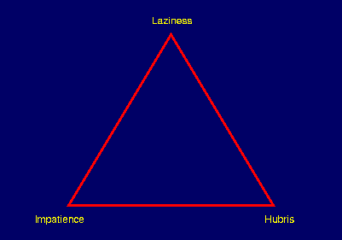
Software Development Methodology
The three virtues of a programmer
--Larry Wall (creator of Perl) https://www.perl.com/pub/1998/08/show/onion.html/
Notes:
You want things to be faster, you want things to be easier (And do what you need), and most importantly, you see a problem and think you can do better.

Slide 46
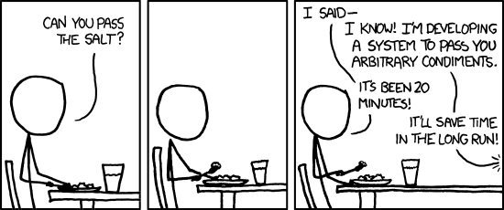
Software Development Methodology
XKCD, Randall Munro--https://xkcd.com/974/
Notes:
You want things to be faster, you want things to be easier (And do what you need), and most importantly, you see a problem and think you can do better.

